Slide 1
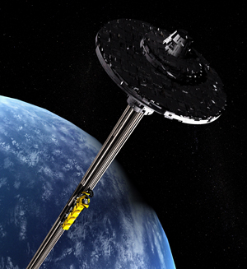
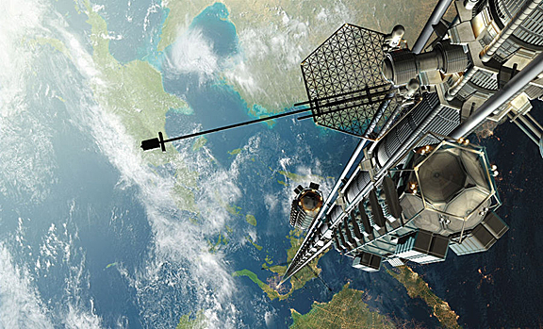
Carbon Nanotubes
http://www.cosmosmagazine.com/node/2435
http://onorbit.com/node/825

Slide 2
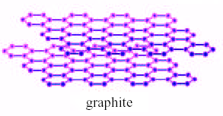
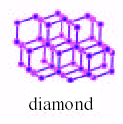
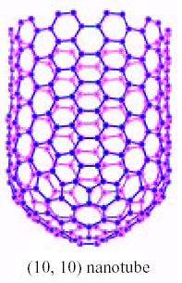
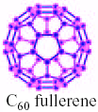
Why do Carbon Nanotubes form?
Carbon Graphite (Ambient conditions)
sp² hybridization: planar
Diamond (High temperature and pressure)
sp³ hybridization: cubic
Nanotube/Fullerene (certain growth conditions)
sp² + sp³ character: cylindrical
Finite size of graphene layer has dangling bonds. These dangling
bonds correspond to high energy states.
Eliminates dangling bonds
Nanotube formation + Total Energy
Increases Strain Energy decreases

Slide 3
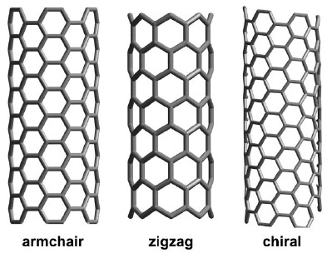
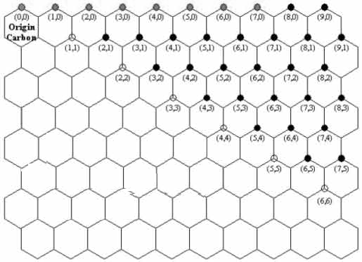
CNT types
INTRODUCTION: CNT types
INTRODUCTION: History
Based on symmetry
(n,m)
n= column
m= row
If:
n=m → Armchair
n≠m → Chiral
(n,0) → Zig-Zag

Slide 4
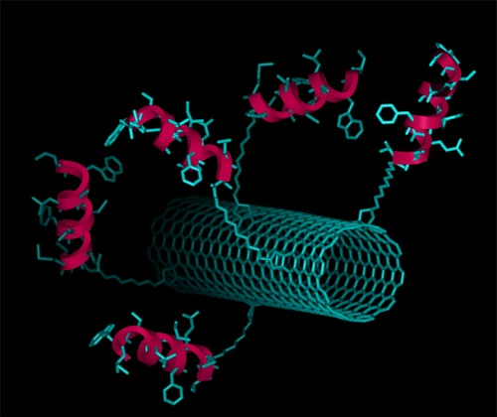
Why Should We Care?
Unique properties
Material of the future
Seemingly infinite applications
Possible health issues
http://www-ibmc.u-strasbg.fr/ict/images/CNT_Peptide.jpg

Slide 5
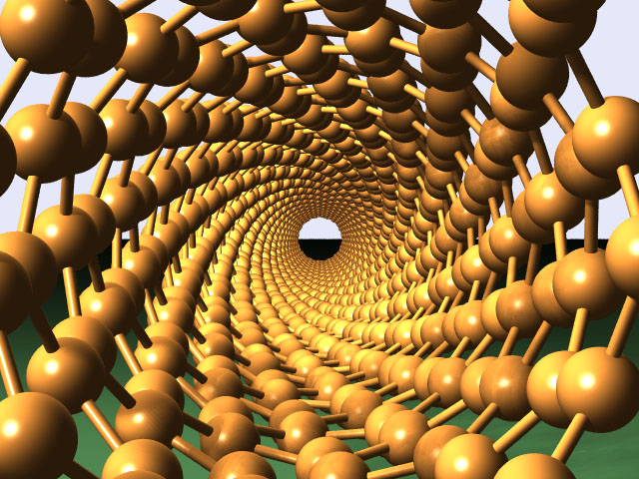
Properties
132,000,000:1 Length-To-Diameter Ratio
Diameter of 3 to 9 nm
Lengths in the millimeter range
Efficient electrical conductors
Can act as both thermal conductors and thermal insulators
http://brent.kearneys.ca/wp-content/uploads/2006/05/carbon_nanotube.jpg

Slide 6
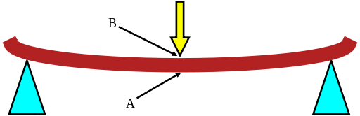
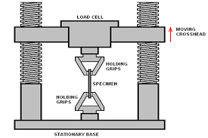
CNT Properties
Properties
Carbon nanotubes are the strongest ever known material.
Stiffness is the extent to which an object can resists deformation in response to an applied force. The complementary concept is flexibility or pliability: the more flexible an object is, the less stiff it is.
Young Modulus (stiffness):
Carbon nanotubes 1250 GPa
Carbon fibers 425 GPa (max.)
High strength steel 200 GPa
Tensile strength (breaking strength)
Carbon nanotubes 11- 63 GPa
Carbon fibers 3.5 - 6 GPa
High strength steel ~ 2 GPa
capacity of a material or structure to withstand loads tending to elongate
Density:
Carbon nanotube (SW) 1.33 – 1.40 gram / cm³
Aluminium 2.7 gram / cm³

Slide 7
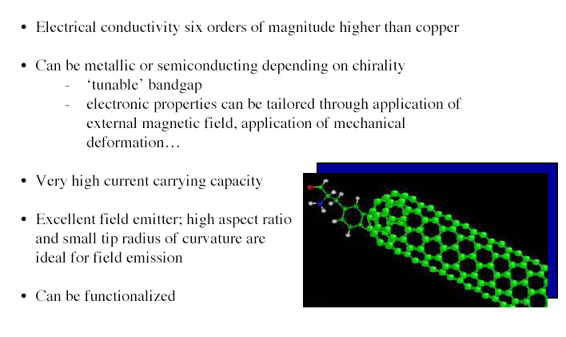

CNT Properties (cont.)

Slide 8
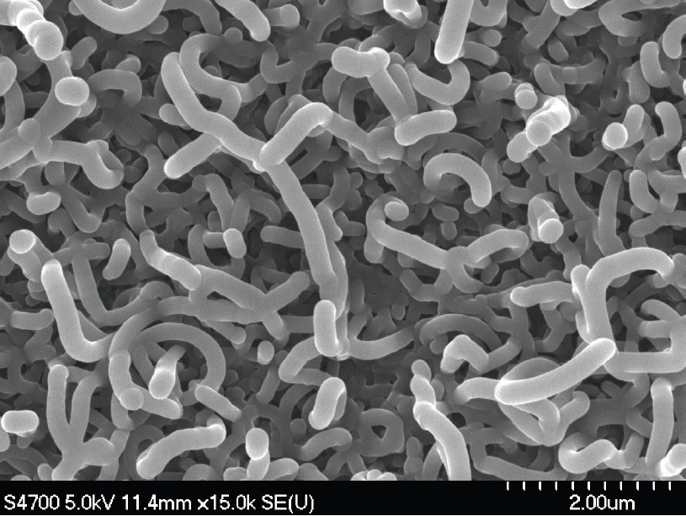
Toxicity
Research is still in the early stages
In rodents, carbon nanotubes have been found to cause several lung issues
The needle-like shape of the fibers is similar to that of asbestos
http://www.phy.mtu.edu/newsletter/research/FatNanotubes.jpg

Slide 9
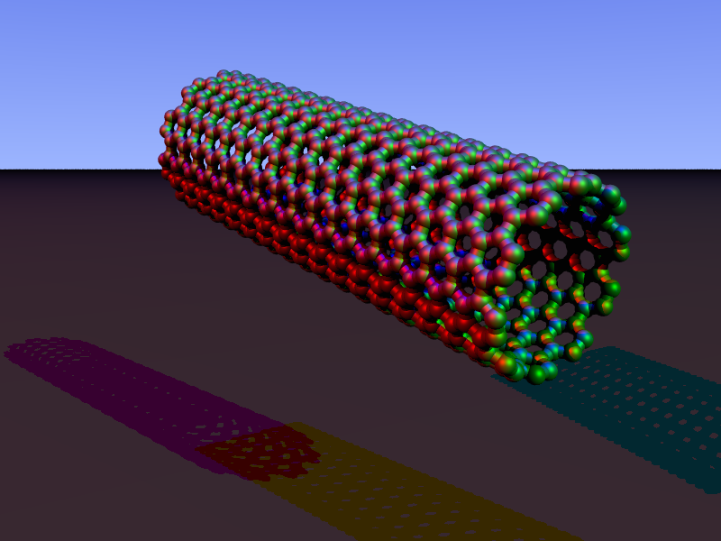
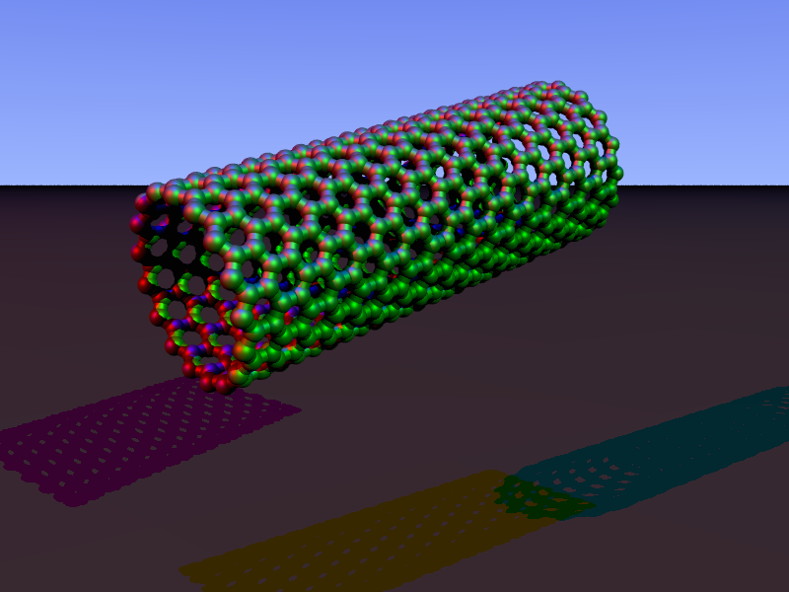
Single-Wall Nanotube (SWNT)
Armchair
Zig-Zag

Slide 10
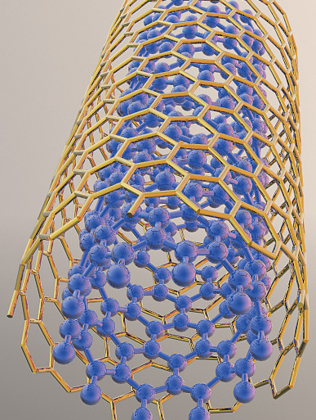
Multi-Walled Nanotubes (MWNT)
Multiple rolled layers of graphene sheets
More resistant to chemical changes than SWNTs
http://www.siemens.com/innovation/en/about_fande/corp_technology/partnerships_experts/uc_berkeley.htm

Slide 11
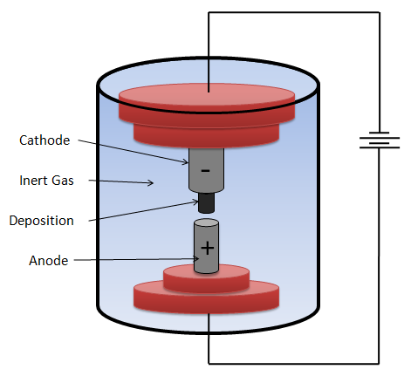
SYNTHESIS
SYNTHESIS
INTRODUCTION: History
I. Arc discharge method
The most common and perhaps easiest way to produce CNTs.
Carbon contained in the negative electrode sublimates because of the high-discharge temperatures.
The yield for this method is up to 30% by weight and it produces both single- and multi-walled nanotubes with lengths of up to 50 micrometers with few structural defects.
Produces a complex mixture of components, and requires further purification - to separate the CNTs from the soot and the residual catalytic metals present in the crude product.

Slide 12
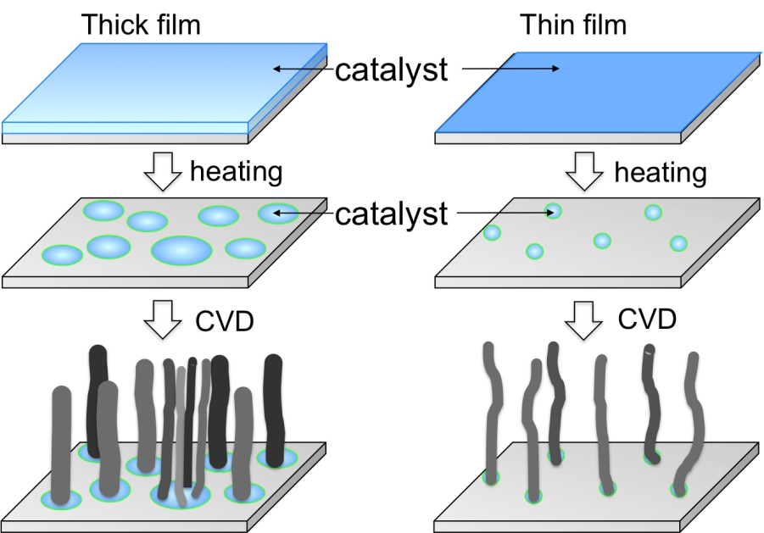
SYTHESIS
SYNTHESIS
INTRODUCTION: History
II. Chemical vapor deposition (CVD)
A substrate is prepared with a layer of metal catalyst particles, most commonly nickel, cobalt, iron , or a combination.
The substrate is heated to approximately 700°C.
two gases are bled into the reactor: a process gas (such as ammonia , nitrogen or hydrogen ) and a carbon-containing gas (such as acetylene , ethylene , ethanol or methane ).
Nanotubes grow at the sites of the metal catalyst; the carbon-containing gas is broken apart at the surface of the catalyst particle, and the carbon is transported to the edges of the particle, where it forms the nanotubes.
Attracted attentions for its feasibility and potential for large-area production with reasonable growth rates at relatively low temperatures.

Slide 13
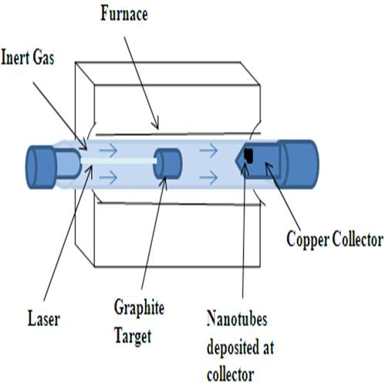
SYNTHESIS
SYNTHESIS
INTRODUCTION: History
III. Laser ablation
A pulsed laser vaporizes a graphite target in a high-temperature reactor while an inert gas is bled into the chamber.
Nanotubes develop on the cooler surfaces of the reactor as the vaporized carbon condenses.
A water-cooled surface may be included in the system to collect the nanotubes.
The laser ablation method yields around 70% and produces primarily single-walled carbon nanotubes with a controllable diameter determined by the reaction temperature .
However, it is more expensive than either arc discharge or chemical vapor deposition.
Notes:
purification:
The main impurities :graphite (wrapped up) sheets, amorphous carbon, metal catalyst and the smaller fullerenes…
Rules : -separate the SWNTs from the impurities
- give a more homogeneous diameter or size distribution.
The techniques that will be discussed are oxidation, acid treatment, annealing, ultrasonication, micro filtration, ferromagnetic separation, cutting, functionalisation and chromatography techniques.

Slide 14
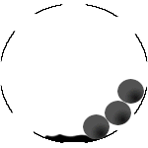
Ball Milling
Powder graphite is placed in a stainless steel container
Argon gas is used
Process occurs at room temperature
Powder is then annealed
http://www.rsphysse.anu.edu.au/nanotube/
Notes:
1 min

Slide 15
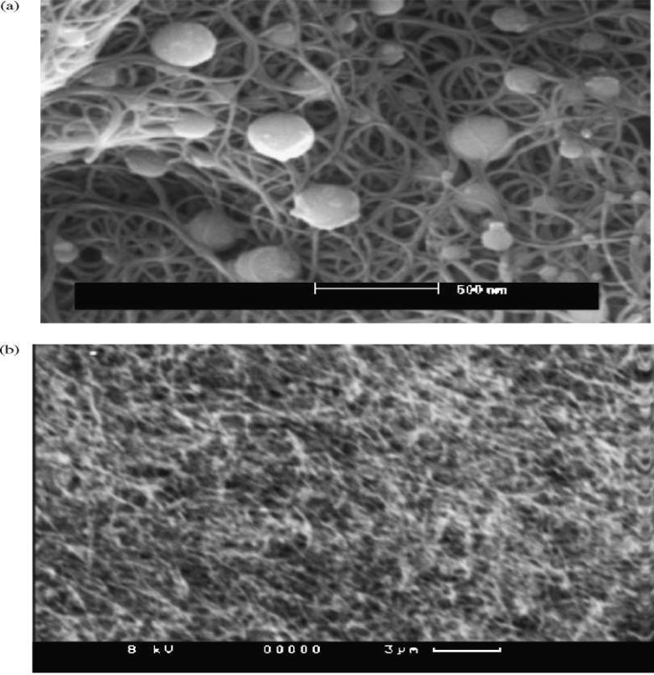
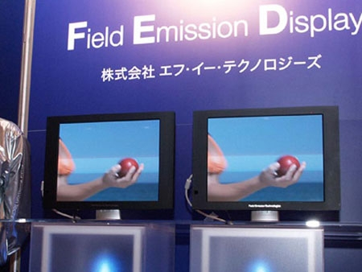
Electrical Application: FED
Field Emission Display ( FED)
Uses electron beam to produce color images (FED)
Traditionally cathode ray tubes are used but recently more focus on using carbon nanotubes
NASA is researching this technology to use in space exploration

Slide 16
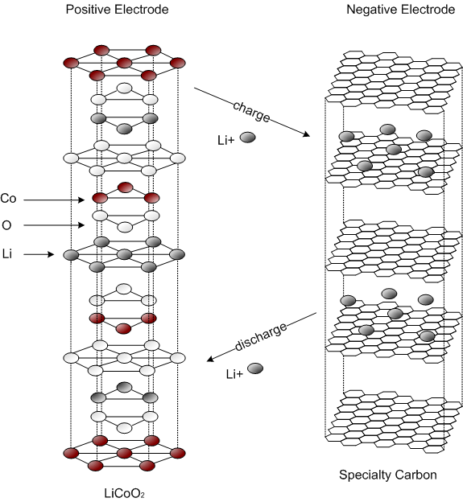
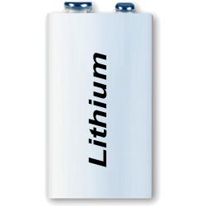
Energy Storage: Lithium batteries
Nanotubes have the highest reversible capacity of any carbon material for use in Lithium ion batteries
Nanotubes have intrinsic characteristics desired in material used as electrodes in batteries and capacitors
Nanotubes are outstanding materials for super capacitor electrodes
They also have a number of properties including high surface area and thermal conductivity that make them useful as electrode catalyst supports in Polymer Electrolyte Membrane (PEM) fuel cells
Notes:
https://www.youtube.com/watch?v=VxMM4g2Sk8U

Slide 17
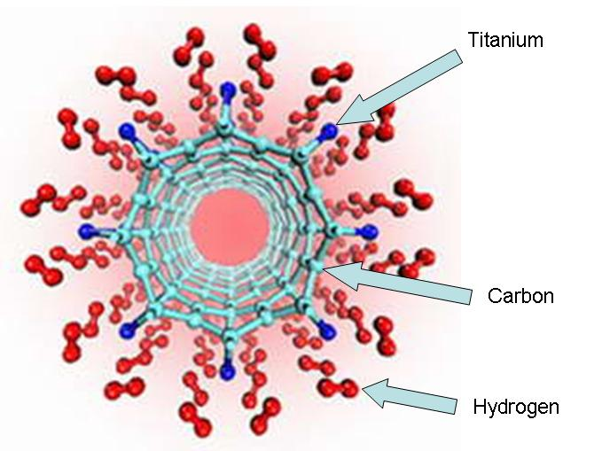
Energy storage: Hydrogen storage
Single-walled carbon Nanotubes can store hydrogen
Nano tube technology will meet the challenge of storing hydrogen and releasing them adequately in hydrogen fuel car in future
Physisorption and chemisorption are mechanisms used for hydrogen storage in carbon nanotubes

Slide 18
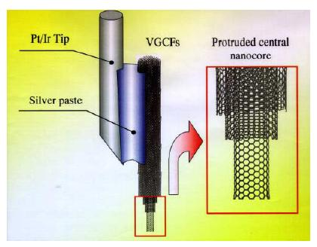
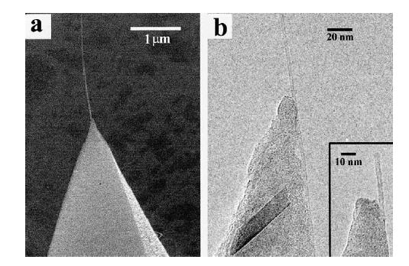
Biological applications: AFM tips
Carbon nanotubes as AFM probe tips:
Small diameter – maximum resolution
Resolution of ~ 12nm is achieved

Slide 19
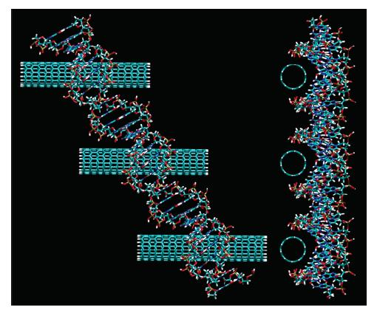
Biological applications: DNA sequencing
Nanotubes fit into the grove of the DNA strand
Apply voltage across CNT, different DNA base-pairs give rise to different current signals
With multiple CNT, it is possible to do parallel fast DNA sequencing
Top view and side view of the
assembled CNT-DNA system
Notes:
DNA sequencing is the process of determining the nucleic acid sequence – the order of nucleotides in DNA. It includes any method or technology that is used to determine the order of the four bases: adenine, guanine, cytosine, and thymine. The advent of rapid DNA sequencing methods has greatly accelerated biological and medical research and discovery.^{[1][2]}
Knowledge of DNA sequences has become indispensable for basic biological research, and in numerous applied fields such as medical diagnosis, biotechnology, forensic biology, virology and biological systematics. Comparing healthy and mutated DNA sequences can diagnose different diseases including various cancers,^{[3]} characterize antibody repertoire,^{[4]} and can be used to guide patient treatment.^{[5]} Having a quick way to sequence DNA allows for faster and more individualized medical care to be administered, and for more organisms to be identified and cataloged.^{[4]}

Slide 20
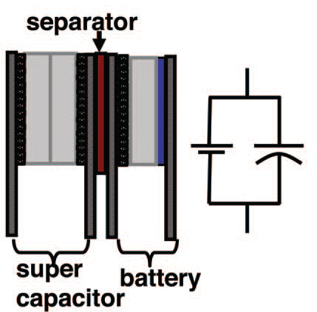
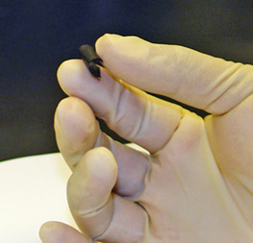
Paper battery
Could easily be mistaken for a sheet of black paper
Functions as both a lithium-ion battery and a supercapacitor
Lightweight, thin, flexible
Can function at a wide range of temperatures
Notes:
The battery is made up of cellulose paper embedded with aligned carbon nanotube electrode and electrolyte; could be mistaken for a simple sheet of black paper.
-The device, engineered to function as both a lithium-ion battery and a supercapacitor, can provide the long, steady power output comparable to a conventional battery, as well as a supercapacitor’s quick burst of high energy.
The battery is lightweight, extremely thin, and flexible. They can be twisted, folded, or cut into any shape with no loss of mechanical integrity or efficiency. The paper batteries can also be stacked, like printer paper, to boost the total power output.
-Has the ability to function in temperatures up to 300 degrees Fahrenheit and down to 100 below zero
-Along with use in small handheld electronics, the paper batteries’ light weight could make them ideal for use in cars, boats, and airplanes
-The device has potential to be a power supply for devices implanted in the body, such as a pacemaker. The naturally occurring electrolytes in human sweat, blood, and urine can be used to activate the battery device.
20

Slide 21
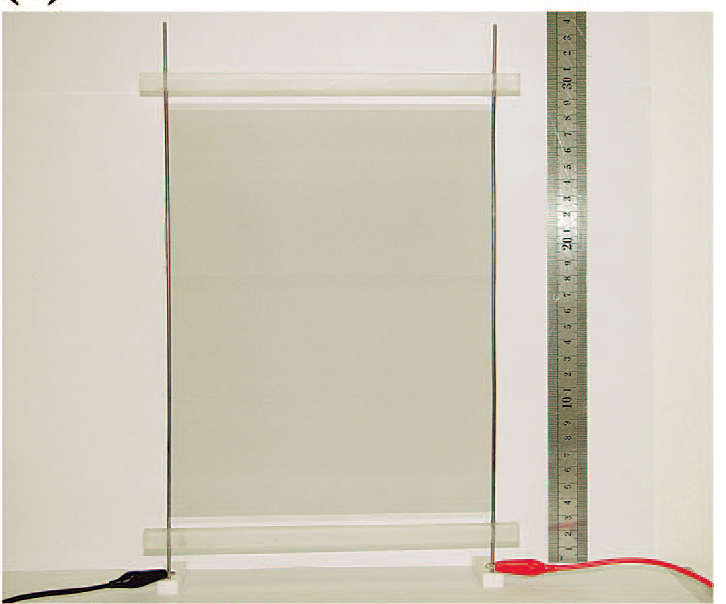
Nanotube speakers
Thin carbon nanotube films can act as speakers
New generation of cheap, flat speakers
Transparent, flexible, stretchable, and magnet free
Notes:
21
very thin carbon nanotube films, once fed by sound frequency electric currents, can emit loud sounds. This could lead to a new generation of cheap, flat speakers
The extremely low heat capacity per unit area of carbon nanotube thin films leads to a wide frequency response range and a high sound pressure level.
carbon nanotube thin film loudspeakers are transparent, flexible, stretchable, and magnet-free.
They can be made into any shape and size, freestanding or on any insulating surfaces.
Since they are transparent when fully stretched, the sheets could be attached to the front of an LCD screen to replace standard speakers.

Slide 22
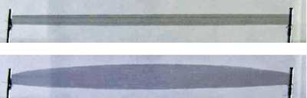
Artificial muscles
Aerogels made from carbon nanotubes (CNTs) can serve as electrically powered artificial muscles
Sheet becomes 220% wider and thicker when voltage is applied
Flexes about 3 orders of magnitude faster and generates more than 30 times the force than human muscles of the same size
Notes:
22
Aerogels made from carbon nanotubes (CNTs) can serve as electrically powered artificial muscles
Turn electrical energy into mechanical energy, have possible applications in robotics, prosthetic devices, and microscopic pumps.
The nanotube aerogel sheets are drawn out of multiwalled CNTs so the nanotubes line up along the length of the sheet.
When a positive voltage is applied to the sheet, the sheet becomes about 220% wider and thicker because of electrostatic repulsive forces.
The sheets flex about three orders of magnitude faster and generate more than 30 times the force compared to the same cross-sectional area of natural human muscles.
They also work over a wide range of temperatures, from 80 to 1500 K,
Additionally, because the density of the sheets changes as they widen and thicken, they may also have applications as tunable electrodes for applications such as solar cells and organic light-emitting displays.

Slide 23
Nanotube thermocell
uses multiwalled carbon nanotubes as electrodes
3 times efficient than conventional
Converts waste heat from industrial plants, pipelines into electricity
Notes:
23
a thermo-electrochemical cell using multiwalled carbon nanotubes as electrodes is able to convert heat into electricity 3x more efficiently than conventional thermocells using platinum electrodes. Proposed applications are converting waste heat from industrial plants or pipelines. It is estimated large thermocells will produce power at $2.76 per watt from freely available waste energy, compared with $4.31 per watt for solar cells.

Slide 24
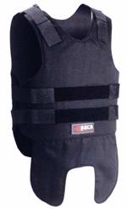
SPECIFIC APPLICATION SUPER STRONG BULLET PROOF JACKETS:-
One of the main applications of carbon nanotubes is super strong bullet proof jackets.
Bullet proof jackets are formed by the carbon nano fibers which are made up of millions of tiny carbon nano tubes is starting to reveal exciting properties.

Slide 25
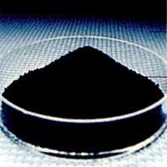
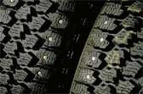
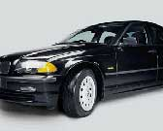
Carbon black
Properties
Large industry
- mill. tons each year
Tires, black pigments, plastics, dry-cell batteries, UV-protection etc.
Size: 10 – 400 nm

Slide 26


Writing
Application
Carbon – graphite
C₆₀: 1000x better resolution than ink (Xerox)

Slide 27
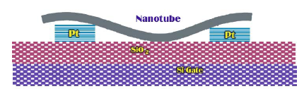
CNT: Implications for electronics
Carrier transport is 1-D.
All chemical bonds are
satisfied ⇒ CNT Electronics not bound to use SiO₂ as an insulator.
High mechanical and thermal stability and resistance to electromigration ⇒ Current densities upto 10⁹ A/cm² can be sustained.
Diameter controlled by chemistry, not fabrication.
Both active devices and interconnects can be made from semiconducting and metallic nanotubes.

Slide 28
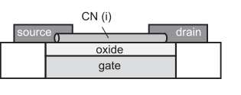
CNT: Implications for electronics
Carrier transport is 1-D.
All chemical bonds are
satisfied ⇒ CNT Electronics not bound to use SiO₂ as an insulator.
High mechanical and thermal stability and resistance to electromigration ⇒ Current densities upto 10⁹ A/cm² can be sustained.
Diameter controlled by chemistry, not fabrication.
Both active devices and interconnects can be made from semiconducting and metallic nanotubes.

Slide 29
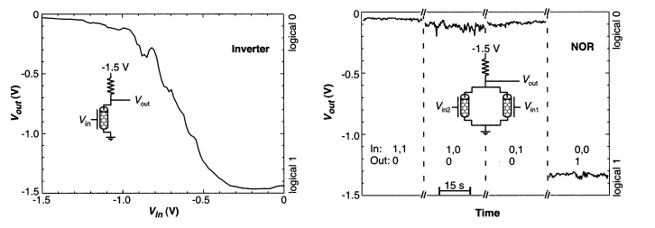
CNT circuits
The input-output characteristics of an inverter stage realized by a CNTFET and an external resistor.
Two CNTFETs in parallel working on a common resistor. Input/output characteristics showing NOR Function
A. Bachtold, P. Hadley, T. Nakanishi and C. Dekker, Science 294, 1317 (2001)

Slide 30
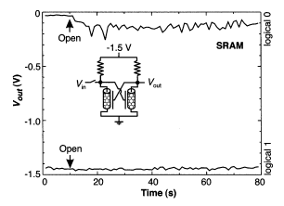
Nanotubes for Memory Applications
A simple SRAM cell made by two cross-coupled CNTFETs with external resistors. Writing either 1 or 0 to the input and disconnecting the input shows that the output remains in the stored state
A. Bachtold, P. Hadley, T. Nakanishi and C. Dekker, Science 294, 1317 (2001)

Slide 31
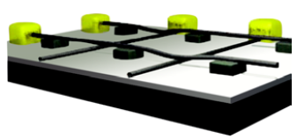
Nanotubes for Memory Applications
Crossbar arrangement of rows and columns of nanotubes separated by supporting blocks. Application of an appropriate voltage between the desired column and row bends the top tube into contact with the bottom nanotube. The resistance drop is used for bit storage. Van der Waals forces maintain the contact even if the voltage is removed (after [68]). Separation of the CNTs is achieved by application of a voltage pulse of equal polarity at the crossing point.
Th. Rueckes, K. Kim, E. Joselevich, G. Y. Tseng, C. Cheung and Ch. M. Lieber, Science 289, 94 (2000)

Slide 32
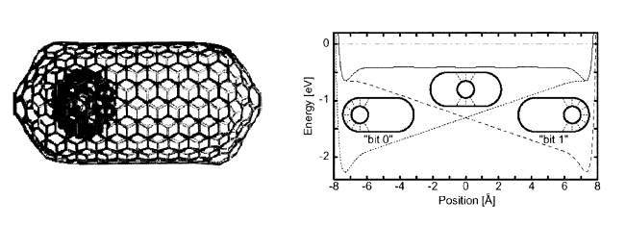
Nanotubes for Memory Applications
A bucky ball incorporated in a short closed carbon nanotube (right). The Van der Waals forces favor two stable positions at both ends of the tube (left) which can be exploited for bit storage.
Y. Kwon, D. Tomanek and S. Iijima, Phys. Rev. Lett. 82, 1470 (1999).

Slide 33
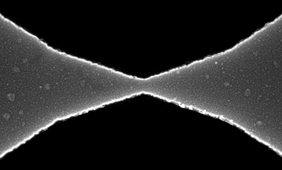
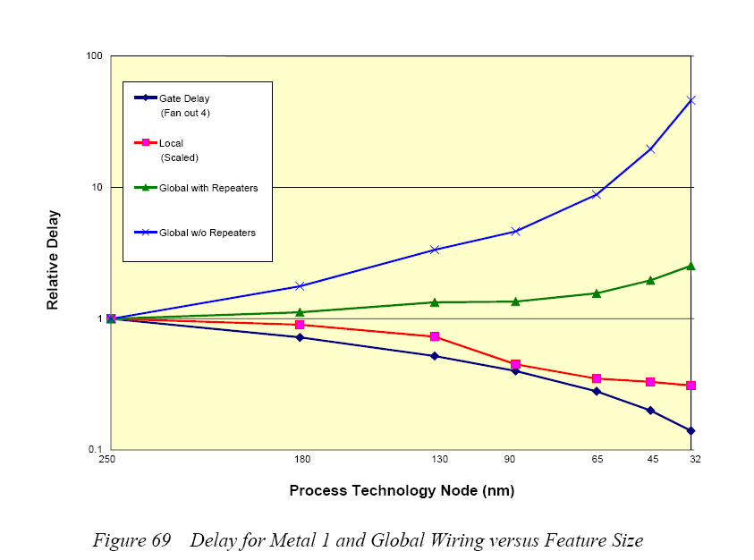
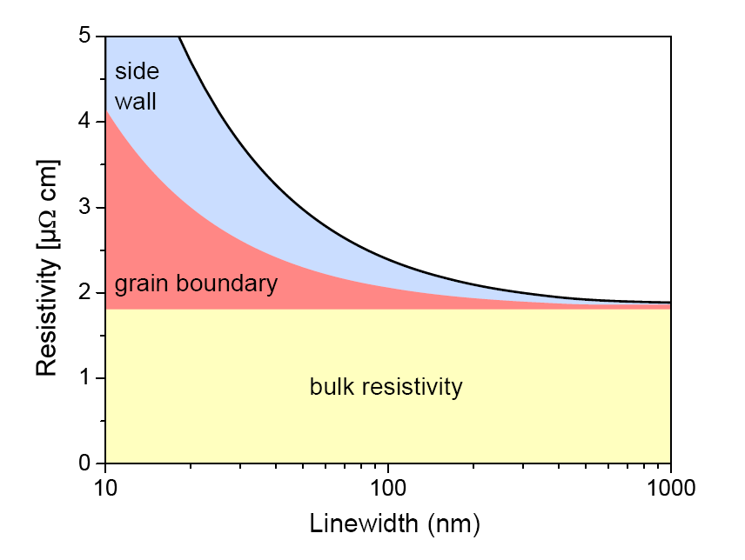
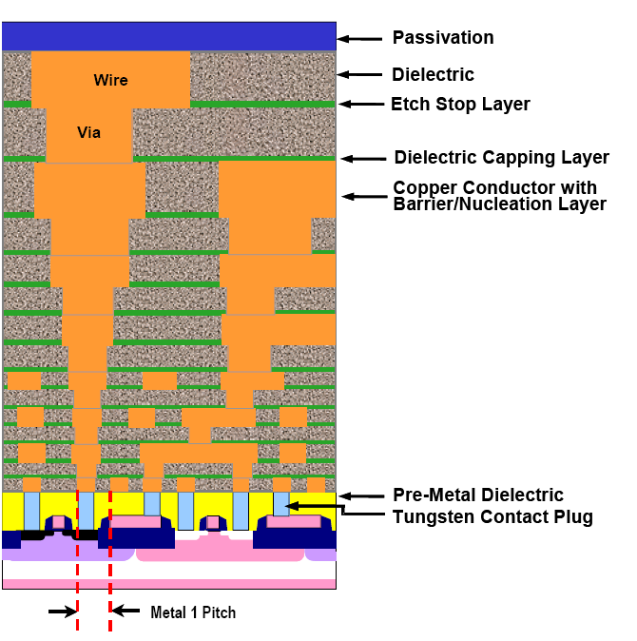
Overview of Interconnects
Increased resistance and decreased current carrying capability due to electromigration are two critical issues affecting the use of copper interconnects
Ron Ho, SLIP 2005
ITRS Roadmap, 2005
Notes:
https://en.wikipedia.org/wiki/Electromigration

Slide 34
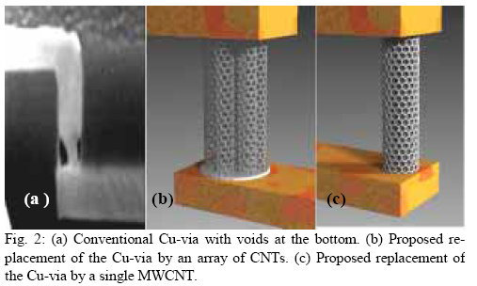
Why Carbon Nanotube Interconnects?
Advantages | CNT | Cu
Mean free path (nm) @ room temp | >1000 | 40
Max current density (A/cm²) | >1x10¹⁰ | ~1x10⁶
Thermal conductivity (W/mK) | 5800 | 385
Problems
High resistance ~6.45kΩ Contact resistance~100Ω Therefore, the NEED FOR CNT BUNDLE 3. Lack of control on chirality
Metallic Carbon Nanotubes are potentially viable for use as interconnects due to their large mean-free path (which leads to low resistance) and low electromigration (which increases current carrying capability)
A. Naeemi, et al, IEDM 2004
F. Kreupl, et al, IEDM 2004

Slide 35
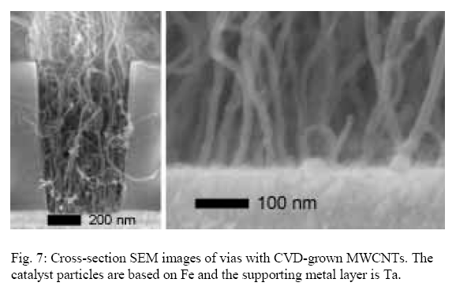
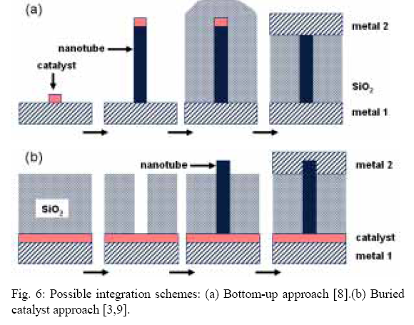

Growth Strategies
(a) Bottom-up approach (b) Buried catalyst approach
Two major growth strategies
Bottom-up, where CNTs are grown before ILD deposition
Buried catalyst, where CNTs are grown after ILD deposition
J. Li, et al, Appl. Phys. Lett. 82, 2491 (2003)
F. Kreupl, et al, IEDM 2004

Slide 36

Results
F. Kreupl, et al, IEDM 2004

Slide 37

Issues
Contact resistance eliminates any advantage seen versus “bulk” Cu interconnects
To make a good low resistance contact, high annealing temperatures are required which exceed the thermal budget
Variability of grown nanotubes continues to be an issue
Large diameter nanotubes underperform Cu vias even under ideal conditions
F. Kreupl, et al, IEDM 2004

Slide 38

All-CNT Nanoelectronics
Concept for an all-CNT-based microelectronics technology. All active elements and interconnects are made out of nanotubes. Due to the quasi-crystalline nature of the nanotubes high quality devices are possible without the need for a single crystal silicon substrate. By the application of well known back-end-of-line techniques cost-effective stacking of a real 3-dimensional structure is feasible.

Slide 39
In Conclusion…
There are many unique properties
Further investigation of toxicity is needed
There are many ways to synthesize
Method of synthesis depends on financial needs and amount of product desired
There are many exciting applications of carbon nanotubes

Slide 40

Questions?

Slide 41
References
www.ece.rochester.edu/courses/ECE580/docs/Nanotubes_Fu.ppt
www.ece.rochester.edu/courses/ECE580/docs/Nanotubes_Fu.ppt
http://www.nanowerk.com/spotlight/spotid=4154.php
http://www.azonano.com/details.asp?ArticleID=980#_Energy_Storage
http://www.sciencedirect.com/science?_ob=ArticleURL&_udi=B6THY-493PC9C-1&_user=952835&_coverDate=12/30/2003&_rdoc=1&_fmt=high&_orig=search&_sort=d&_docanchor=&view=c&_searchStrId=1231942804&_rerunOrigin=google&_acct=C000049198&_version=1&_urlVersion=0&_userid=952835&md5=03c5f21cb002be312d9fc81685b8914b
http://www.icdd.com/resources/axa/vol47/v47_33.pdf
http://lnnme.epfl.ch/page80437.html
http://students.chem.tue.nl/ifp03/synthesis.html
http://www.azonano.com/details.asp?ArticleID=1561
http://nanopatentsandinnovations.blogspot.com/2009/12/arkema-combines-ball-milling-with-vapor.html

